Slide 1


Predicting 3pt shooting in the nba
A review and comparison of machine learning methodologies
By Koi Stephanos

Slide 2


Exploring the data
Shooting trends and statistics for the first two Calendar months of the season
Only 108 players, fair distribution in 3pt ability (very small sample size)
Listed here are:
Col_0 -> Labels
Col_1 -> Predictive Target
Col_2-13 -> Provided Features
Col_14-18 -> Engineered Features
Total points contains small variance due to rounding in the base shooting statistics
 | three_pct_season | lwr_paint_pct_oct_nov | upr_paint_pct_oct_nov | mid_pct_oct_nov | three_non_cnr_pct_oct_nov | three_cnr_pct_oct_nov | ft_pct_oct_nov | lwr_paint_shots_oct_nov | upr_paint_shots_oct_nov | mid_shots_oct_nov | three_non_cnr_shots_oct_nov | three_cnr_shots_oct_nov | ft_shots_oct_nov | net_avg_pct_oct_nov | total_attempts | total_points | ts_pct
mean | 0.361 | 0.575 | 0.435 | 0.407 | 0.366 | 0.355 | 0.801 | 88.138 | 40.425 | 24.092 | 39.435 | 57.472 | 69.425 | 0.527 | 318.99 | 322.05 | 0.463
std | 0.039 | 0.083 | 0.091 | 0.121 | 0.088 | 0.068 | 0.083 | 42.961 | 25.618 | 13.055 | 15.021 | 28.042 | 46.346 | 0.056 | 121.38 | 127.02 | 0.039
min | 0.220 | 0.278 | 0.167 | 0.000 | 0.150 | 0.167 | 0.500 | 14 | 10 | 10 | 11 | 12 | 7 | 0.390 | 89 | 86.014 | 0.382
25% | 0.337 | 0.514 | 0.388 | 0.330 | 0.307 | 0.316 | 0.741 | 54 | 23 | 14 | 28 | 35 | 34 | 0.487 | 229 | 232.66 | 0.430
50% | 0.366 | 0.578 | 0.444 | 0.402 | 0.364 | 0.359 | 0.811 | 85 | 34 | 22 | 40.50 | 55.50 | 58 | 0.518 | 301.50 | 304.90 | 0.461
75% | 0.387 | 0.625 | 0.488 | 0.477 | 0.426 | 0.394 | 0.868 | 111.25 | 50 | 31 | 49 | 74.25 | 96 | 0.566 | 390 | 389.84 | 0.493
max | 0.437 | 0.800 | 0.692 | 0.900 | 0.667 | 0.500 | 1.000 | 238 | 170 | 72 | 82 | 159 | 213 | 0.692 | 644 | 699.06 | 0.564

Slide 3
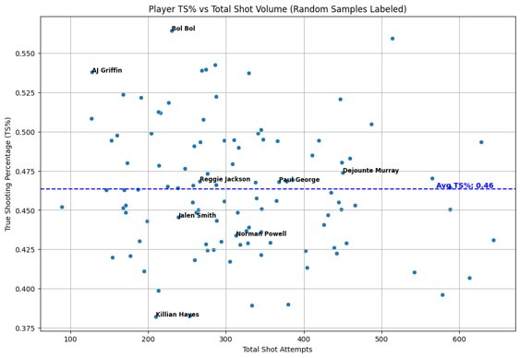
feature engineering
NetAvg and TrueShooting % calculated from raw stats
TS% Formula: 0.5*(Total Points)/[(Total Field Goal Attempts) + 0.44*(Total Free Throw Attempts)]
NetAvg Formula: CountShotType * %ShotType for type in ['lwr_paint', 'upr_paint', 'mid', 'three_non_cnr', 'three_cnr', 'ft']
Graph displaying Efficiency/Volume for players in the dataset. Players above the blue axis outperform league average.
Cite: nbastuffer.com/analytics101/true-shooting-percentage/

Slide 4
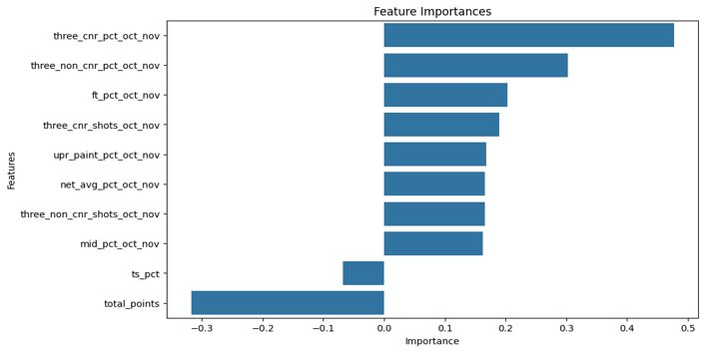
feature selection
Recursive Feature Elimination used to select top 10 features
Features are removed and the model is re-trained to evaluate largest contributors
Top Features are ranked by Importance
The absolute value of the derived feature coefficient
Raw percentage stats have positive coefs
Conversely, total points and true shooting skewed negative
Chosen features suggest relevance of 3-pt volume/location
No additional shot volume statistics were selected

Slide 5
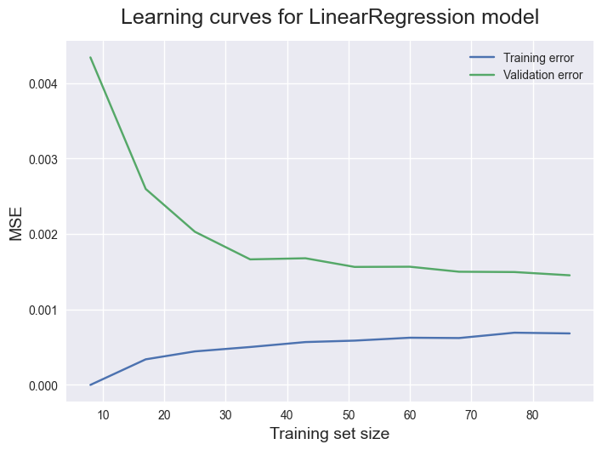
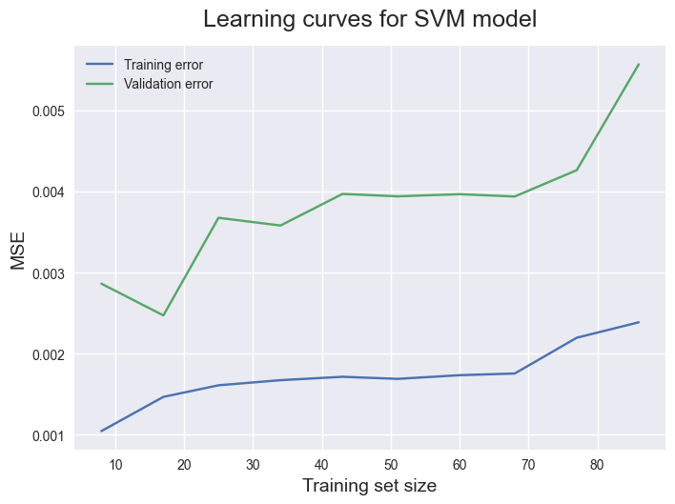
linear models
Linear Regression
Classic prediction model, assigns coefficient weights to the features for linear predictions
Often used as a baseline for comparison
Demonstrates classic learning curve showing tightening of mean squared error with validation set as training set size increases
Support Vector Machine
Calculates a hyperplane within the feature space to interpret new data
Favorite in NBA Analytics, particularly in action detection
Struggles by overfitting to the data, indicated by the spike in validation error as training size increases
Cite: linear regression, support vector

Slide 6
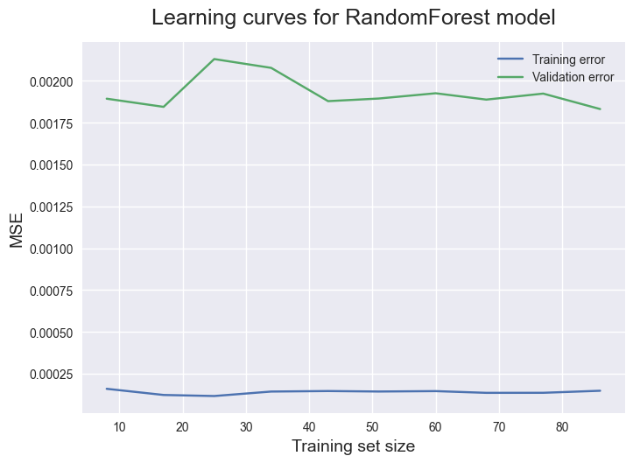
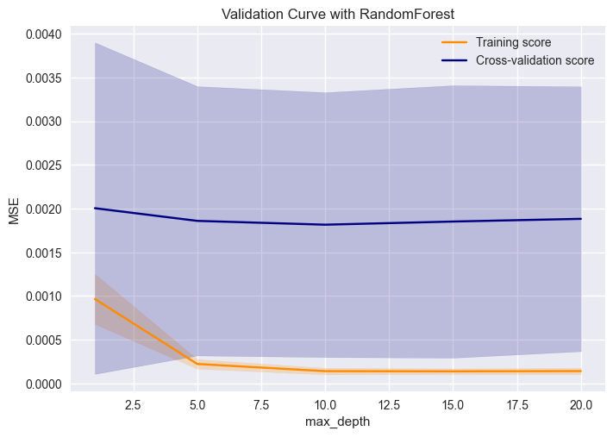
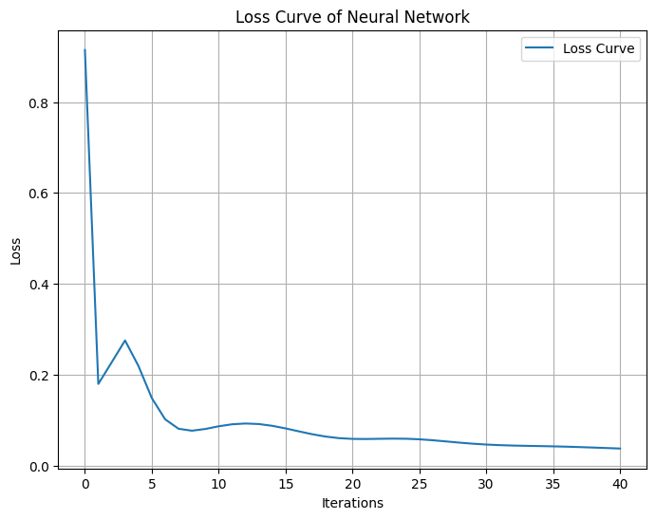
non-linear models
Random Forest
Uses a collection of decision trees to model the data, allowing for a sophisticated, non-linear model
Powerful ensemble learning method
Training score remains low throughout, with near constant validation as well, indicating a potential learning plateau in the model
Neural Network
Deep learning tool that uses layers of 'neuron' nodes to model complex non-linear relationships in the data
Model converges well around the 10 epoch mark, after some early volatility
Cite: random forest, nueral network

Slide 7
Conclusion
Ultimately, all models achieved strong mse ratings, able to correctly predict 3pt percentages at the end of season within a couple thousands of a point
Of the non-linear models, the Random Forest out-performed the Neural Network, and classic Linear Regression had the strongest stats overall
While predicting well, both the Support Vector and Neural Network approaches appeared to struggle in explaining the variance, indicated by negative R² scores, suggesting overfitting, which can likely be attributed to the small sample size
For this dataset, Linear Regression is the winner, with Random Forest a suitable alternative that potentially might fair better with more training data
 | Linear Regression | Support Vector | Random Forest | Neural Network
MSE | .001 | .002 | .001 | .0027
R² | .331 | -6.07 | .264 | -0.85

Slide 8
Thank you for your consideration!!
All code for this project is available on github

